Slide 1
Cold Calling 101
Notes:
To change the image on this slide, select the picture and delete it. Then click the Pictures icon in the placeholder to insert your own image.

Slide 2
Agenda
Cold Calling Basics
Successful Cold Calling
AVR, Gatekeeper, Assistants & Voicemail
Sample Script
Questions Before Giving Pricing
How To Close More Business

Slide 3
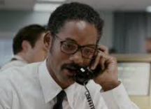
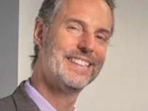
The Truth
https://www.youtube.com/watch?v=emzARZsJntw

Slide 4
Cold Calling 101 Basics
What is your goal? Profile/Appt/Sale
Focus on your target market
Profile your company before calling
Refer to competitors who partner with you
Think “what do they want” when calling – stay in what does this mean to them
Always get something from every call
Buyers have changed
Need to nurture the lead to a sale

Slide 5
Successful Cold Calling
How to get to the decision maker???
Know the person’s name
Don’t sound like a typical sales person
Don’t get screened! Give them your name and ask if the contact is in today
Upmarket -Don’t leave a VM until you tried a couple times
Don’t be a stalker
Good News - It is all a numbers game!
Only 1 in 10 dials will have success in a connection
Only 1 in 4 calls will have any short term success
You need to dial the phone 40 times to come away with a lead. You need to find your own number

Slide 6
Calling The Decision Maker
AVR Systems
Gatekeeper
Assistants
Voicemail

Slide 7
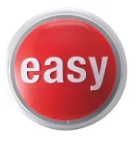
Automatic Voice Response
Don’t hit zero but listen for the directory
Try a name – Smith
“ I am sorry Mary…I was trying to reach…
Customer Service
Zero for operator
After 5:00 pm the directory kicks in

Slide 8
Gatekeeper
The gatekeepers goal is to keep you out
Sound professional not friendly
Be Brief – “John Jones”
You will be screened – Be prepared
Ping Pong
“Who may I say is calling?
“Maureen Wozniak – is he in?” – ask a question back. This is truly want you want to know – are they in?

Slide 9
Assistants
Not part of a first attempt
Try Ping - Pong
Engage if necessary
Can be useful – if engaged in the right way
Be polite and ask of their help

Slide 10
Voicemail
Hit zero and see if their there
Upmarket -Don’t use on first few attempts
Can be used to get information in front of them
Follow up a day later with e-mail
Don’t leave a second message unless they engage

Slide 11
The Message
Hi Mr(s) Jones sorry I missed you. My name is Maureen Wozniak from the BBB and I have helped the ABC company and XYZ company to increase their sales with the leads and inquires we send them through our website. We help buyers find them online and strengthen their online reputation management.
I am reaching out to you to share with (company’s name) and how we were able to achieve this. Are you the right person in the organization that looks at these issues? My number is _______ but I realize you must be busy so I will send a follow e-mail with my contact information from (Your Companies Name).”
Thank You

Slide 12
Calling into the C-Level
Loosen up – these are conversations
People like to buy – hate to be sold
Don’t rely on them to know they need your solution
Education (helped …. With….) and ask questions
Have you ever looked into _______?
When does your company look into?
Who is responsible for ______ decisions? I will keep you updated..
“Part of my job……”

Slide 13
Sample Script
Hi _______ my name is ____________I am the Major Accounts Manager with the Chicago and Northern Illinois Better Business Bureau –I hope your well. I’m calling on a positive note - based on your history, it appears that you are qualified to receive an invitation for accreditation through the BBB. Did you know that you actually have an A+ rating? Y/N – Well, not everyone qualifies to go through accreditation – companies like (competitor & competitor) it really leads to these main benefits – much higher trust with the buyers, greater SEO rankings on Google, online positive reputation management and inbound referrals directly from our site – which here in Chicago and Northern Illinois, gets over 25,000 inquiries - a day!
Are you familiar with the BBB? Have you looked into getting accredited before?

Slide 14
Questions Before Giving Pricing
What exactly are you looking for?
How will that help you with ……?
What is your time table to get this in place?
Who else is going to help you with this decision?
Have you identify a budget?
Any reason you would not make this change?

Slide 15
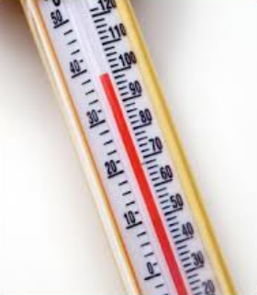
Closing Quesiton
How does the pricing look to you?
We could have this to you by _____ how is that date?
Any reason not to move forward with this? Any reason this would not be a fit for your company?

Slide 16
THANK YOU

